Slide 2

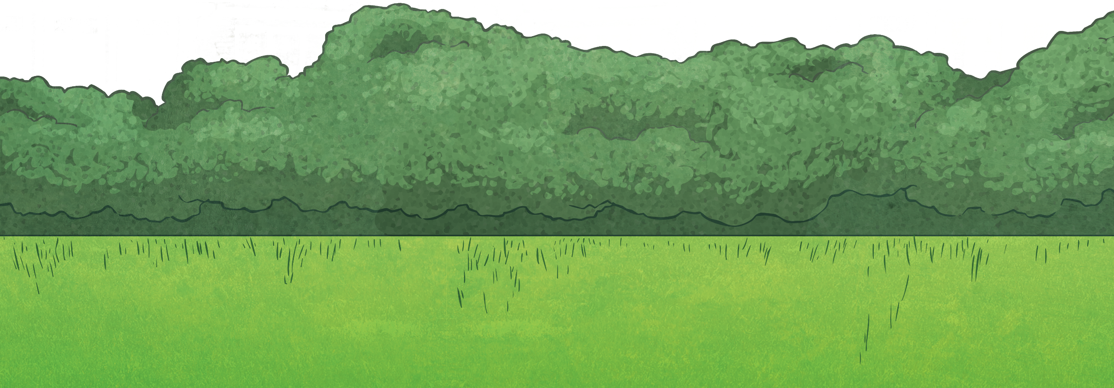
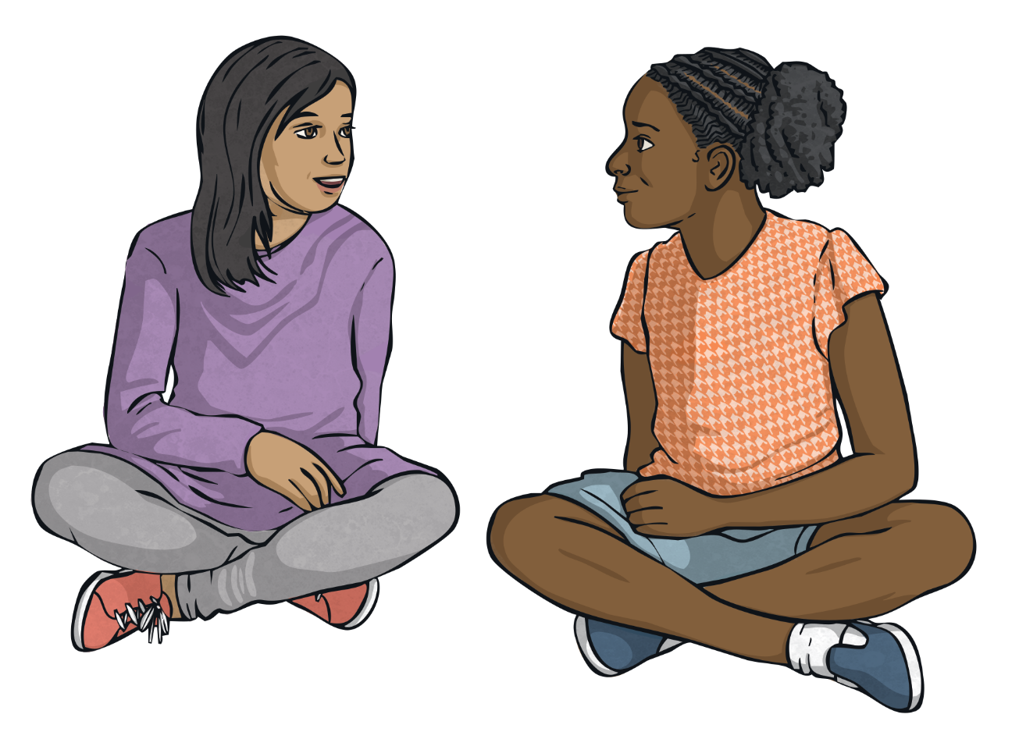
What is the Purpose of an Information Report?
The purpose of an information report is to present information about an object, animal, person or place.
They provide the reader with information, facts and evidence about a topic without providing personal opinion.

Slide 3
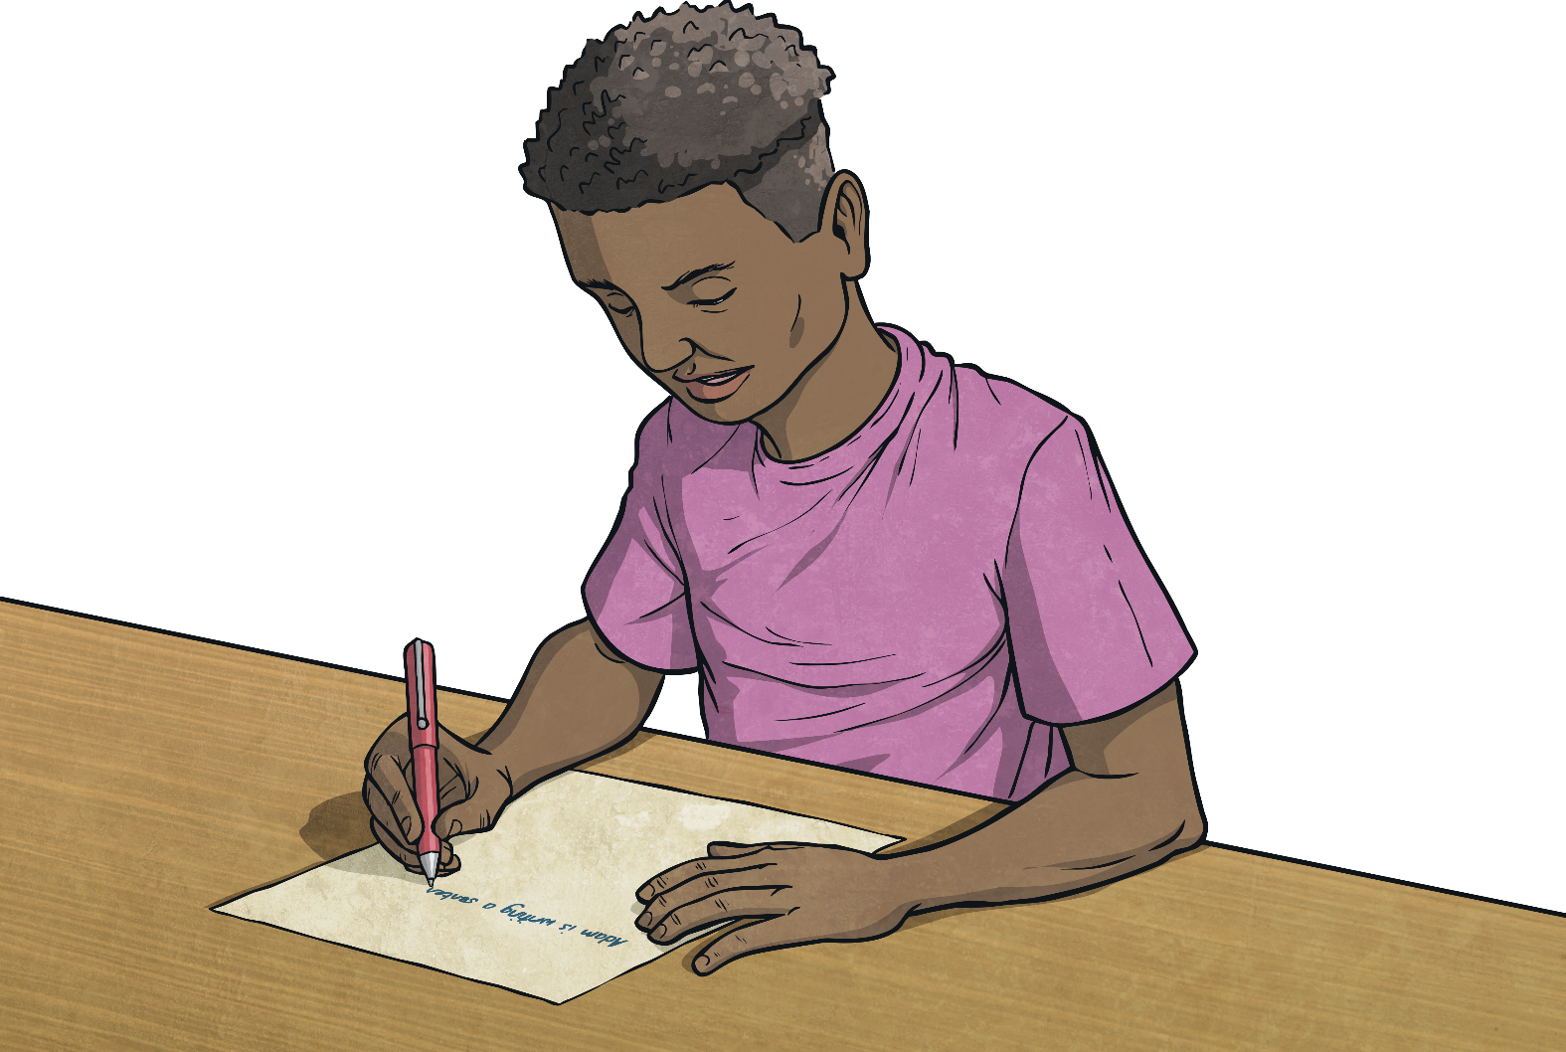
Features of an Information Report
An information report...
presents information about something (usually a category or class of things such as animals, planets, countries etc.)
includes a general statement that identifies or defines the topic or subject of the report
is structured using paragraphs, to give information
uses topic sentences to provide details about the information within each paragraph
may also include illustrations, diagrams, charts or maps.

Slide 4


Language Used in an Information Report
The language used in an information report should include...
present tense
subject specific vocabulary
precise detail such as dates and names.

Slide 5
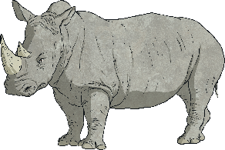

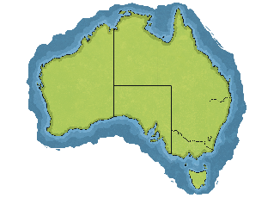
Types of Information Reports
There are three main types of information reports. They are...
1
Scientific Reports: describing the appearance and behavior of the subject of the report.
2
Technological Reports: focused specifically on the components and uses of technology.
3
Social Studies Reports: descriptions of people, places, history, geography, society, culture and economy.

Slide 6

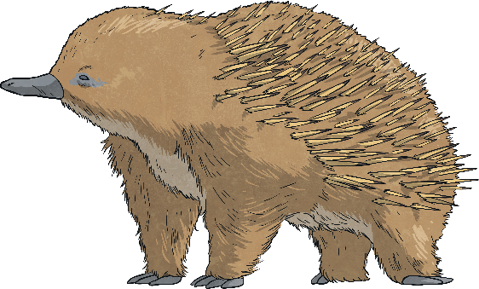
Information Report Example:
Echidnas
General Statement
The echidna, sometimes called the spiny anteater, is part of a very small and special group of mammals called monotremes. This means that they lay eggs but feed their babies milk.
Appearance
Echidnas have hair all over their body and sharp spines or spikes covering their back. They have big, strong claws that they use for digging and a long pointy nose.
Habitat
Echidnas are found right throughout Australia, in a wide range of habitats and climates. They generally will shelter in rock crevices or hollow logs.
Diet
Echidnas almost only eat ants and termites, but also sometimes eat tiny beetles or even worms. They use their long thin sticky tongue to help them get the ants or termites out of their nests.

